Slide 1
Yahoo – DevOps POD model

Slide 2
Navin/ Gandhi
Our Understanding of AOL requirement

Slide 3

Legend
Current Operating Model
AOL
LTIMindtree Offshore
VP - Software Systems Engineering
Delivery Partner
Director - Software Dev Engineering
Delivery Manager
AOL Team
Core Team
AOL Product Areas
DevOps
Technical Lead
(1)
DevOps
Associate
(1)
Princ Software Apps Engineer
(3)
Princ Software Dev Engineer
(2)
Sr Software Dev Engineer
(5)
LTIMindtree
Support Functions
Talent Manager
PMO Support
DevOps Practice
Learning and Development
Software Dev Engineer
(5)
Sr System Engineer
(1)
Sr Software QA Engineer
(1)

Slide 4
Optional slide as DevOps also means ways of working and not just CI/CD automation
Typical DevOps Maturity Model
DevOps hopes to achieve a continuous delivery model. In order to get there both Dev and Ops teams should synchronize their ways of working across all aspects of the product lifecycle and leverage automation of the delivery pipeline. A snapshot of how maturity levels are achieved in DevOps mode of working from different start to different end states are shown below:
DevOps
Build
Test
Provision
Deploy
Report
Level 5
Complete
Ops and Dev share responsibility
End-to-end automated gated builds
100% automated all the way to prod
Self service portal for requesting env
Continuous end-to-end deployment
Predictive analysis and trends added
Level 4
Advanced
Envoys from Ops and Dev participate in each others group
Central build env.Team actively reuses generic components in secure and controlled manner
Auto dynamic security, functional and performance
Env can be build up/torn down at push of button,OS virtualized
Test gated deployment of end-to-end apps. Deployment occur over diff env
Dashboards incl insights from multiple perspectives and shows history
Level 3
Average
Dev and Ops work together when required
Build on commit. Archived components available for use by other teams
Auto static code and security analysis
Env are identical, several tools used for provision and configure
One-click deployments for all env.
Graphical and textual reports in dashboard
Level 2
Beginner
Dev release notes for Ops
Auto builds in central area and activated manually
Auto unit / component testing at check in
Scripted install for each component on server, others manually configured
Self service deploy to Dev and Test env
On request, graphical
Level 1
Base
Ops engaged at end of project
Builds on local workstation by one or more scripts
Manual testing / some automated but manually initiated
Manual install and configure of software
Separate deployment and DB scripts, manual configuration / installs-per-env
On request, textual

Slide 5
Transformation of CI/CD automation
Within an overall DevOps transformation CI/CD automation maturity typically progresses as below:
Establish Business Objectives & Baselines
Standard CI/CD Automation
Integrated CI/CD Automation
Continuous improvement
Tooling & Infra assessment Prepare Roadmap to desired automation transformation
Organizational Change Management Assessment
Finalized/ Rationalized Tools
Standardized version control
Build & release automation
Shift Left Testing
Regression Automation
Monitoring coverage
Tools Optimization
Containerization
Integrated Security
Advanced test automation
Infra Automation
DevOps Metrics driven insights
Microservices
Site Reliability engineering
ML based analytics for CD pipelines
Skills, Culture, Governance, Learning
Self managed teams with cross skilled capabilities
As portfolios settle into product aligned teams, different configurations due to architecture, application type and complexity can emerge. Owing various factors like skill alignment, cost optimization, effective utilization DevOps too can evolve as a horizontal to support various teams
Product Area A
Product Area B
Product Area C
Client Domain
Owner
Client Product
Owner
Client Product
Owner
Client Product
Owner
Product Governance Council
Product A.3
Product A.2
Enterprise Arch.
Product A.1
Feature teams working on
loosely coupled architecture
Feature teams working on enterprise platforms
Integrated teams for maintenance-only applications
Agile
DevOps
Shared Support Services
Other Horizontals
Security | Automation
Compliance | Governance etc.
Capability Teams
Platform Management, Infrastructure Management

Slide 6
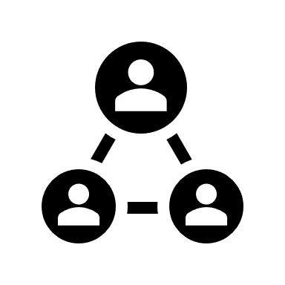


POD model for DevOps
Staff Augmentation
POD Based
Output Based
Resource allocation
Customer owns resource
Customer owns project delivery
Customer owns deliverables
Customer owns reporting
People based pricing
Fixed POD of resources
Fixed set of skills within a POD
LTIMindtree owns the POD
LTIMindtree owns agreed upon deliverables
Joint planning & demand management
POD based pricing
Jointly agreed backlog prioritization and release plan
Joint planning and demand management based
Flex resources ramp up ramp down based on demand spikes
Story point- based pricing
6
POD responsibilities including ramp up, ramp down, skill retention will be owned by LTIMindtree
POD will work seamlessly as a unit of skill combination, making it possible to take advantage of team synergies
Lower management complexity compared to resource augmentation
Utilize LTIMindtree’s tried and tested onboarding and training approach to shorten the learning curve
Reporting on POD performance and KPIs will be owned by LTIMindtree
Leads to a better co-development engagement with shared responsibilities between AOL and LTIMindtree
Recommendation
Increase the DevOps team from 2 to a 10–12-member horizontal DevOps POD

Slide 7
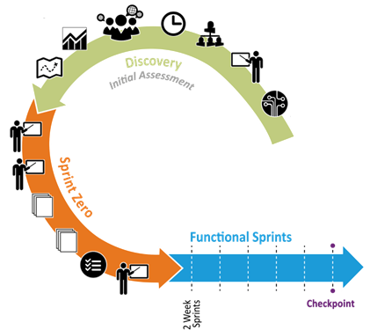

How to get there…
Realignment to new processes
Conceptualize
Iterate
Deliver
Finalize governance and other aspects
Transition to Agile
Sprint-0
Functional Sprints
Rollout
Assess current state
    Finalize transformation plan for DevOps POD
    Assess DevOps roadmap, Release goals, Culture, Security, ways of working, SRE Automation opportunities, DevSecOps maturity levels
    Realign Process, Tools, technical setup towards new ways of working etc. with stakeholder buy-in
    Strategize consolidation for people, process, WoW, program governance etc.
    Define new team structure
    Stabilize the team
    Prioritize the DevOps backlog for at least 3 Sprints
    Review and finalize DoR, DoD
    Tool Finalization (project management & engineering related, performance & security related)
    Evaluation of automation use cases and setup required for the same
    Catalog dependencies, assumptions and risks
    Baseline KPIs, Metrics
    Sprint Initiation
    Sprint planning.
    Daily standups
    Build the CI/CD pipelines, automation use cases, test & integrate. Execute DevOps support tasks
    Sprint review/demo, retrospective
    Capture metrics & visualize
    Continually Groom and prioritize the DevOps user stories, tasks and spikes
    Collaborate with product teams
    Rollout pipelines to all environments
    Incorporate feedback
    Post-Release Support
    Capacity planning and tweaking
Transition to Agile
Sprint 0
planning
Finalize transformation plan
Backlog refining and stabilization
Engagement Initiation
Finalize and configure tools
Deliverable: DevOps output and support for Production rollouts on demand
Determine KPIs and Metrics
Sprint Initiation
Deliverable: Transformation roadmap, Finalize all strategies & plans
Deliverable: Groom backlog for 3 sprints. Readiness of people, tools, processes, metrics to initiate DevOps
Deliverable: DevOps outputs – pipelines, support tasks etc. Governance reports (SLA, Agile KPIs), Sign Off

Slide 8
Legend
Future Operating Model
AOL
LTIMindtree Offshore
Head- Product group
Account Manager
Engineering Manager
Delivery Manager
AOL Team
LTIMindtree DevSecOps POD(s)
Program Manager/Scrum Master
Core Team
AOL Product Areas
DevOps Architect
(1)
DevOps
Lead
(1)
Infra Engineer
(1)
Cloud Engineer
(1)
Architect
Product Owner
Product SME
SRE Lead
(1)
DevOps/SRE Engineers
(7)
Product teams
LTIMindtree
Support Functions
PMO Support
DevOps Practice
Learning and Development

Slide 9
Benefits of moving from TnM towards POD based model
…. Why would we recommend our customers to transform themselves into POD model

Slide 10
AOL/Yahoo support required/ Next steps
…. Changes Required from AOl/Yahoo side.. changes in teams/processes, ways of working, collaboration with other teams.

Slide 11
Thank You

